Slide 1

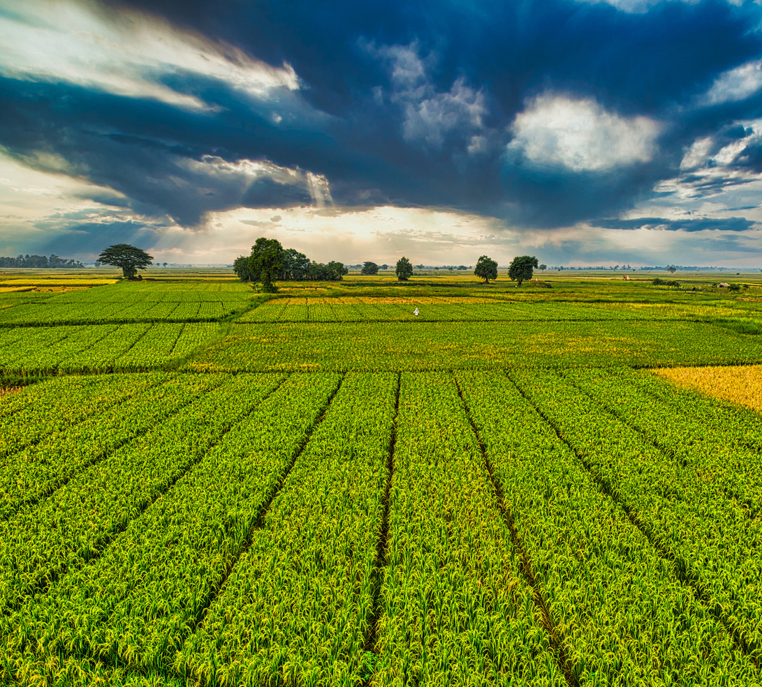



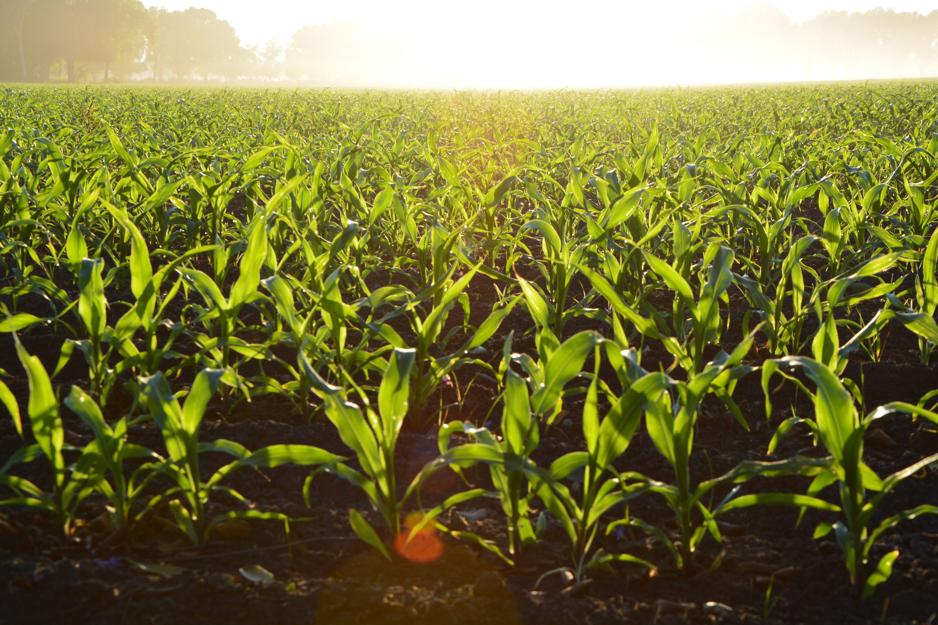

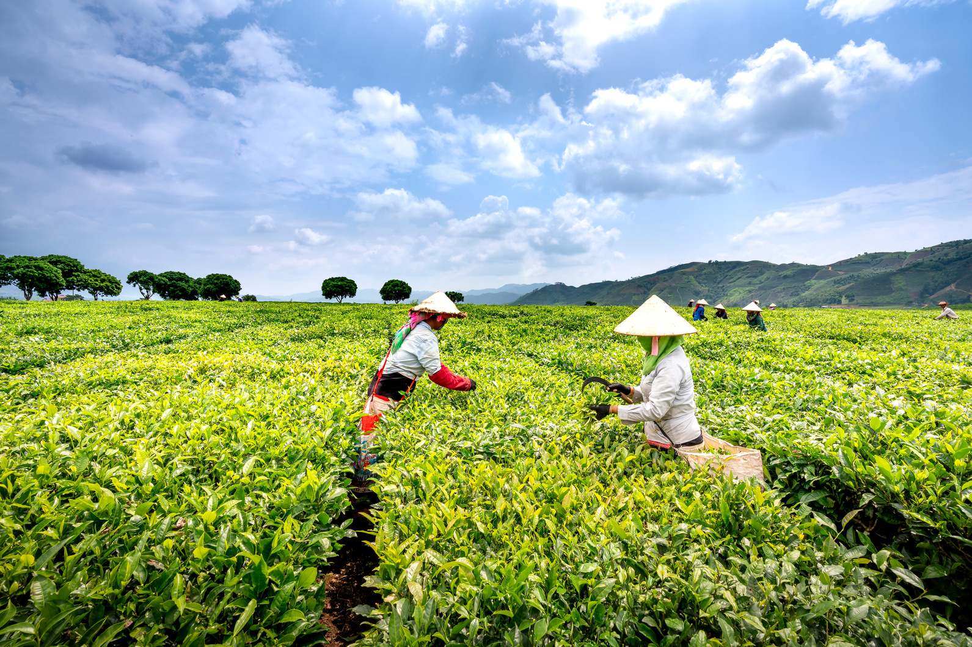


JULIET F. KUKUIA
Environmental Food Production Dashboard
Assessing Sustainability Through Data-Driven Insights
START SLIDE

Slide 2




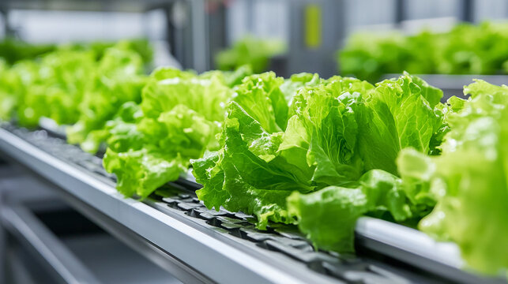


INTRODUCTION
Food production plays a critical role in shaping global sustainability outcomes. While essential for human survival, it is also one of the largest contributors to environmental challenges, including greenhouse gas emissions, land degradation, freshwater scarcity, and eutrophication. This project evaluates the footprints of 43 food products across 12 food groups, focusing on CO₂ emissions, land use, water scarcity, and eutrophication.
PAGE 02

Slide 3



J.F KUKUIA
HOME
INTRODUCTION
INSIGHTS
RECOMMENDATIONS
OBJECTIVES
Evaluate the environmental impacts of food production across CO₂, land use, water use, and eutrophication
Identify hotspots in food groups and production stages
Provide actionable insights for policymakers, producers, and consumers
Document methodology and deliverables via GitHub repository
Support sustainable food system decision-making
PAGE 03

Slide 4



J.F KUKUIA
HOME
INTRODUCTION
INSIGHTS
RECOMMENDATIONS
TOOLS USED
Power BI: Dashboard creation and analysis
Power Query & DAX: Data cleaning and measures
GitHub: Repository for documentation and code
Excel: Preliminary dataset exploration
PAGE 04

Slide 5

J.F KUKUIA
HOME
INTRODUCTION
INSIGHTS
RECOMMENDATIONS
CRISP-DM Framework
BUSINESS AND DATA UNDERSTANDING
DATA PREPARATION AND MODELLING
EVALUATION AND DEPLOYMENT
Define problem & questions
Explore the dataset
Clean and model data
Build KPIs and visuals in Power BI
Validate insights (hotspots, trade-offs)
Deliver dashboards, GitHub repo, presentation
PAGE 05

Slide 6
J.F KUKUIA
HOME
INTRODUCTION
INSIGHTS
RECOMMENDATIONS
Which food groups generate the highest CO₂ emissions per kg?
What are the water-scarcity hotspots across food groups?
PAGE 06
BUSINESS & ANALYTICAL QUESTIONS
How does land use vary by product category?
Which lifecycle stages contribute most to emissions?
Which foods have multi-dimensional sustainability trade-offs?

Slide 7
J.F KUKUIA
HOME
INTRODUCTION
INSIGHTS
RECOMMENDATIONS
KPI INSIGHTS
Meat and stimulants dominate CO₂ intensity.
Most foods fall under High/Very High emission intensity
Total Emissions
Average CO₂ per kg
Average land use per kg
Average water scarcity per kg
256.8 CO₂e/kg across 43 food products
6.0 CO₂e/kg
29.3 CO₂e/kg
36.6K
PAGE 07

Slide 8
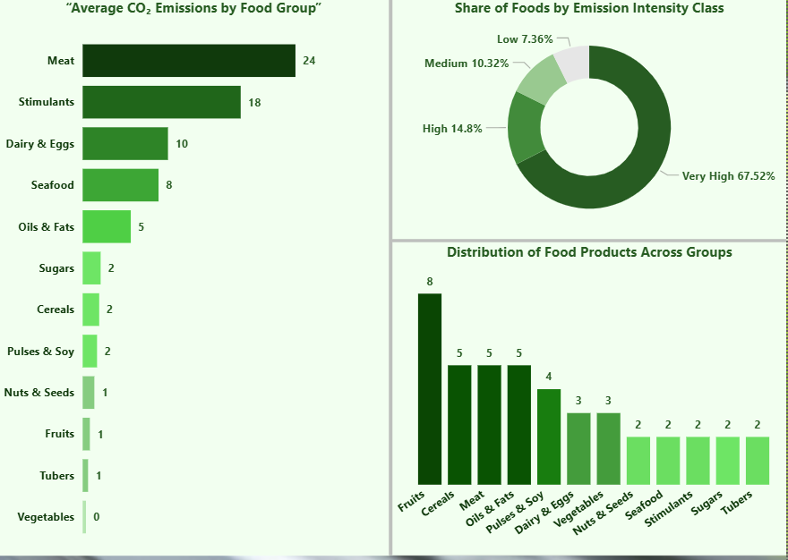

J.F KUKUIA
HOME
INTRODUCTION
INSIGHTS
RECOMMENDATIONS
OVERVIEW OF INSIGHTS
Food Group Leaders: Meat (24) and stimulants (18, e.g., coffee, cocoa) are the biggest emitters.
Vegetables and tubers contribute almost negligible emissions.
Emission Intensity Classes: Very High impact foods dominate (67.5%), with high (14.8%) and medium (10.3%) following. Only a small share is low impact
PAGE 08

Slide 9
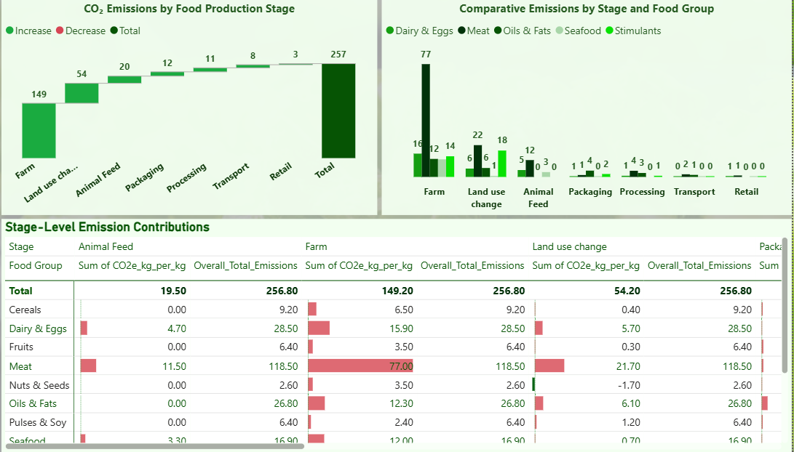
J.F KUKUIA
HOME
INTRODUCTION
INSIGHTS
RECOMMENDATIONS
LIFECYCLE STAGE ANALYSIS
Stage Contribution: Farming dominates with 149 kg CO₂e, making it the single largest contributor.
Comparative Analysis: Meat and dairy are the largest contributors in farm and animal feed stages.
Stage-Level Table: Shows that meat emissions come from multiple stages, with farm (77) and animal feed (11.5) being critical hotspots.
PAGE 09

Slide 10
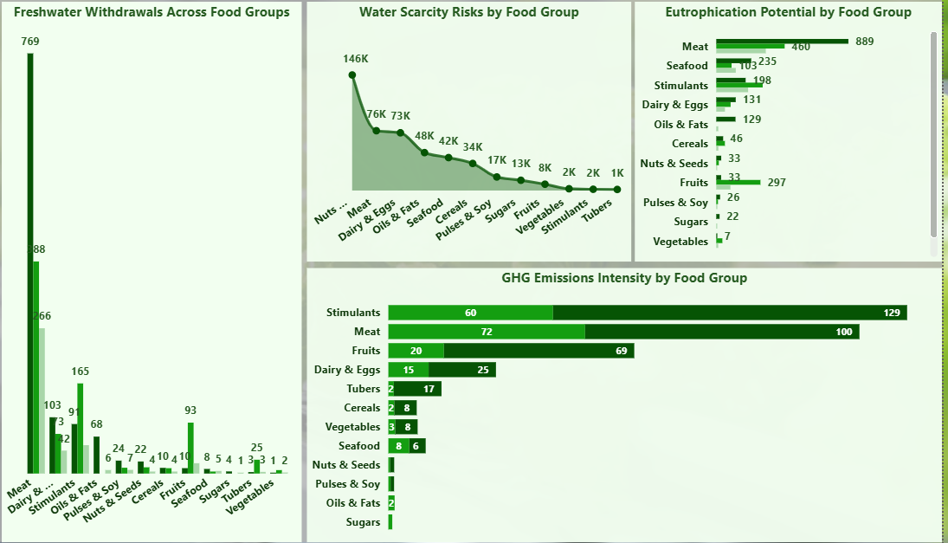
J.F KUKUIA
HOME
INTRODUCTION
INSIGHTS
RECOMMENDATIONS
ENVIRONMENTAL FOOTPRINTS
Meat (769) and dairy/eggs (266) are the most water-intensive.
Nuts (146K litres) and meat (76K) dominate, suggesting high geographic stress in production regions.
Meat (400) and seafood (255) drive nutrient pollution (e.g., runoff into rivers).
Stimulants (129) and meat (72) stand out again, showing strong carbon and methane contributions.
PAGE 10

Slide 11
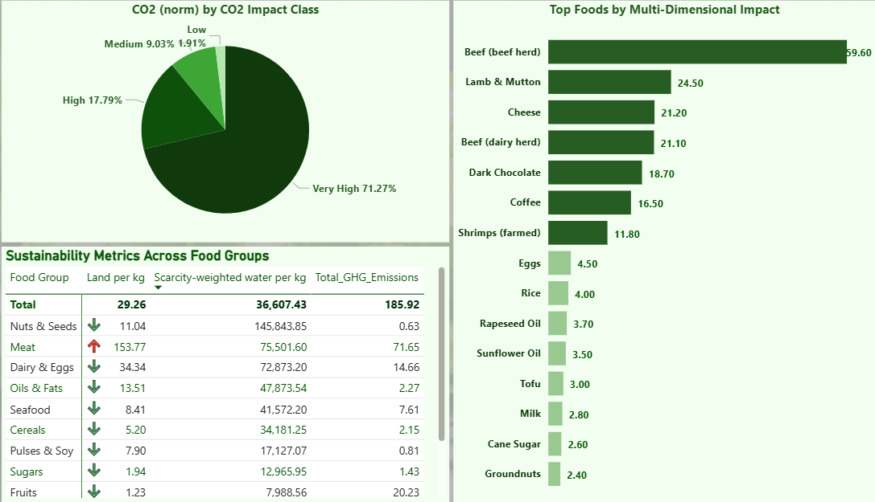
J.F KUKUIA
HOME
INTRODUCTION
INSIGHTS
RECOMMENDATIONS
TRADE-OFFS & HOTSPOTS
High CO₂ intensity foods also require high land and water
Beef, lamb, and chocolate emerge as top hotspots
Pulses and vegetables offer lower trade-offs
Bar charts show relative sustainability
Animal-based foods dominate the hotspots, with beef standing out as the single largest contributor across all dimensions.
PAGE 11

Slide 12

J.F KUKUIA
HOME
INTRODUCTION
INSIGHTS
RECOMMENDATIONS
FINAL DELIVERABLES
GitHub Repository: README, scripts, documentation, dashboards
Power BI Visualisation File
Presentation (this deck)
Documentation with CRISP-DM process and results
PAGE 12

Slide 13
J.F KUKUIA
HOME
INTRODUCTION
INSIGHTS
RECOMMENDATIONS
RECOMMENDATIONS
Policymakers: Promote low-impact food production
Producers: Optimise farming practices and land use
Consumers: Shift diets to lower-impact foods
Future Work: Expand dataset to cover regional variation
PAGE 13

Slide 14

J.F KUKUIA
HOME
INTRODUCTION
INSIGHTS
RECOMMENDATIONS
CONCLUSION
Environmental footprints vary widely by food group and lifecycle stage. Livestock and stimulants carry the greatest burdens across CO₂, water, and eutrophication.
Farming stages and animal feed are the most emission-intensive lifecycle points.
Plant-based foods generally show lower impact, but nuts are an exception due to water intensity.
Beef (especially beef herd) is the top global hotspot, making it the key target for sustainability interventions.
PAGE 14

Slide 15


J.F KUKUIA
HOME
INTRODUCTION
INSIGHTS
RECOMMENDATIONS
THANK YOU!
PAGE 15
Protecting our environment is vital for life on Earth. Let’s work together to maintain our planet’s balance.

